Slide 1



HIDDEN LOGIC Presents
BASIC QUIZ GAME

Slide 2

TEAM MEMBERS
NIRANJAN
DHARNISH
DHILIPAN

Slide 3
PROBLEM STATEMENT:
OBJECTIVE: Create a python-based interactive quiz game.
FOCUS: Validate answers, score responses, and provide instant feedback.

Slide 4
INTRODUCTION
Console-based multiple-choice quiz game.
Demonstrates Python fundamentals are used such as loops, dictionaries, and input validation. Real time user interaction and scoring.

Slide 5
TECHNOLOGIES USED:
LANGUAGE: Python
ENVIRONMENT: Any Python IDE (e.g., PyCharm, VSCode)
CORE FEATURES: Dictionaries, loops, and conditionals.

Slide 6
SOFTWARE REQUIREMENTS:
OS: Windows/MAC/Linux
PYTHON VERSION: IDLE(Python 3.13, 64-bit)
LIBRARIES: Built-in-python modules only

Slide 7
PACKAGE AND METHODS:
DICTIONARIES: Store questions and answers.
LOOPS: Iterate through questions.
CONDITIONALS: Validate responses.
INPUT/OUTPUT: Interact with users.

Slide 8
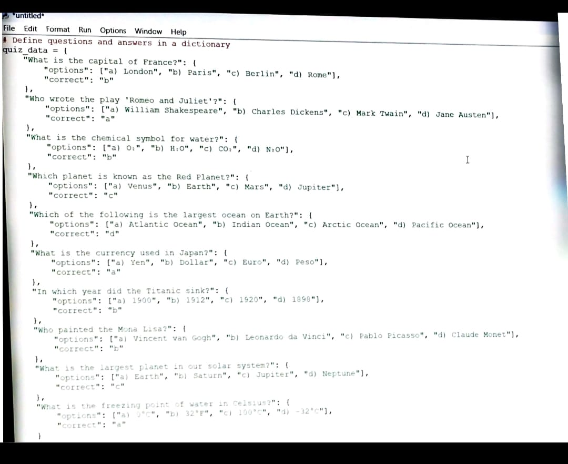
Program code:

Slide 9
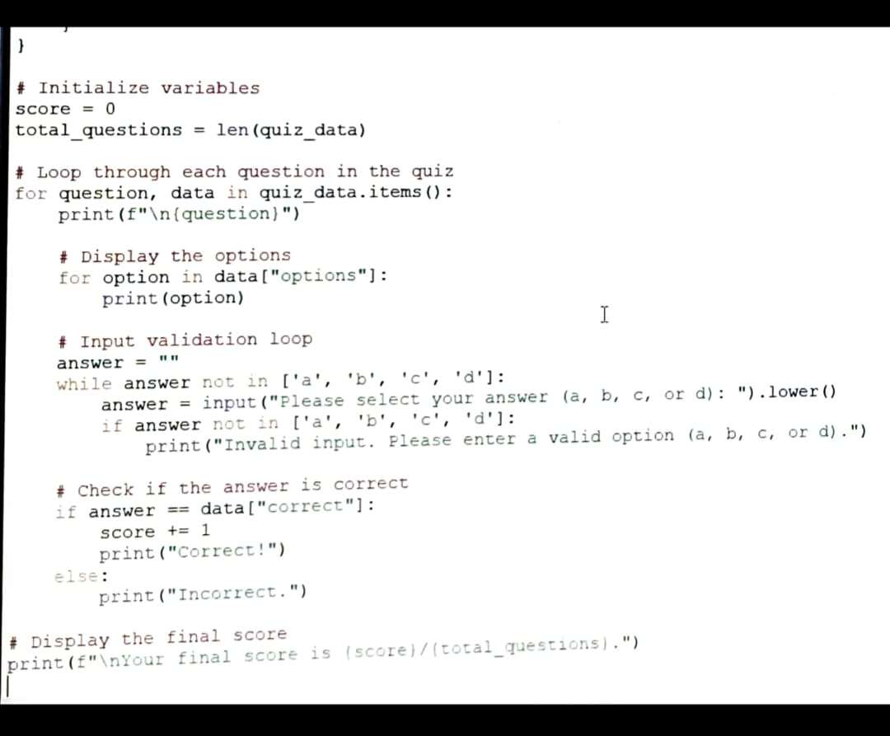

Slide 10
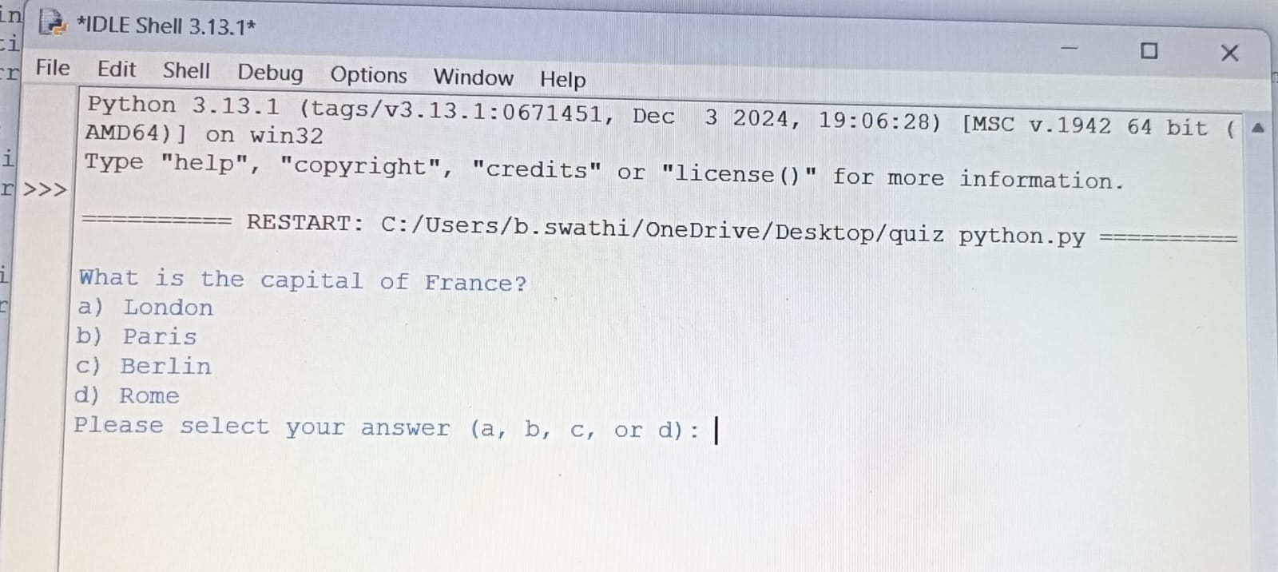
OUTPUT OF THE PROGRAM:
INITIAL QUESTION PROMPT:

Slide 11
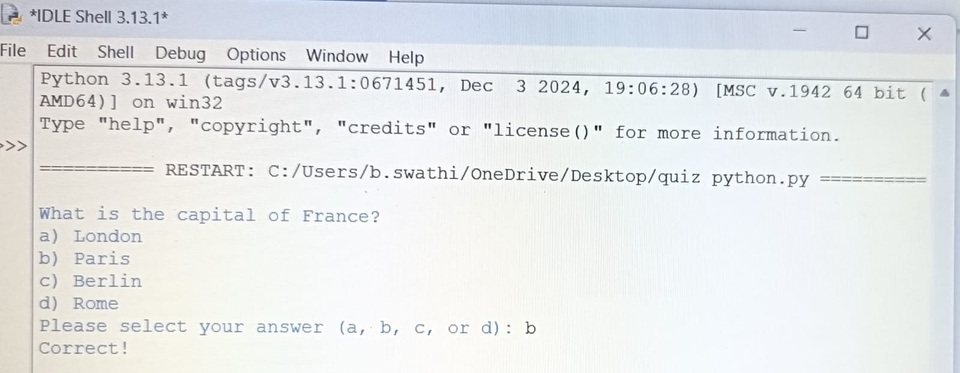
FEEDBACK ON ANSWER: Indication answer(correct or incorrect)

Slide 12
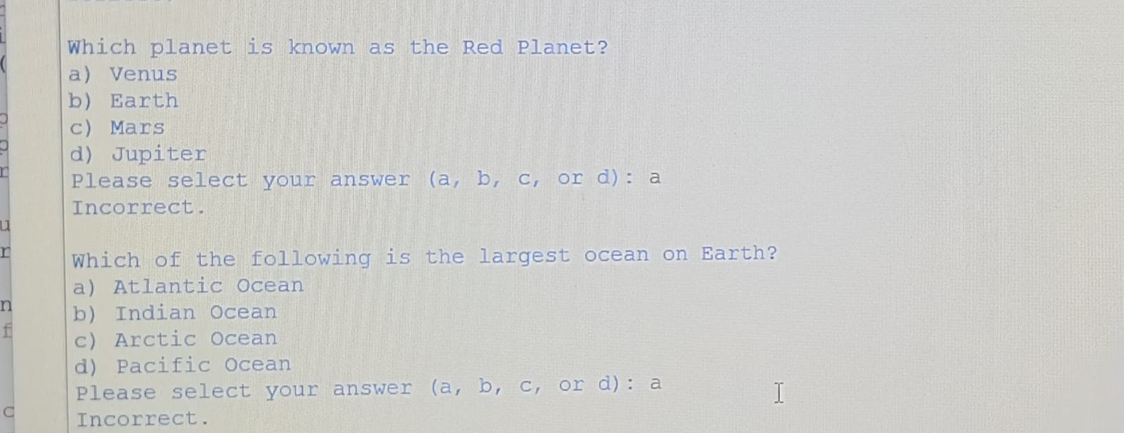

Slide 13
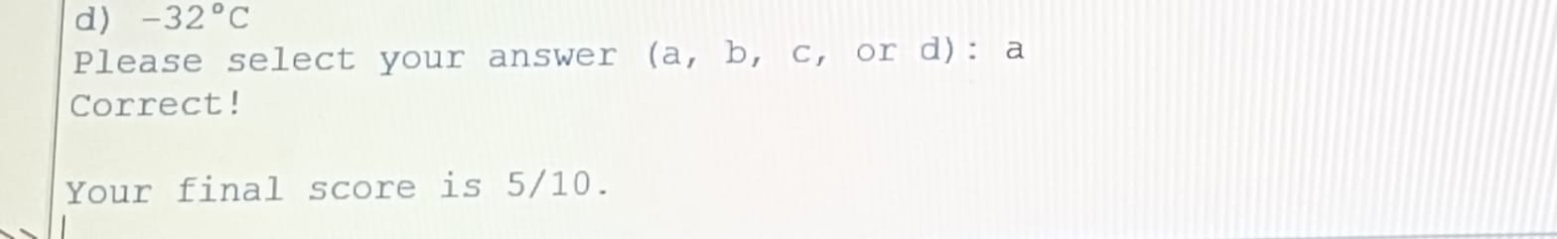
FINAL SCORE:

Slide 14
CONCLUSION
A Practical application of python basics. User-friendly, interactive and extendable. Suitable for learning and demonstration purposes.
FUTURE SCOPE: GUI integrstion (e.g., Tkinter), web hosting with Flask/Django, Timer-based challenges and leaderboards.

Slide 15
THANK YOU

